Slide 1
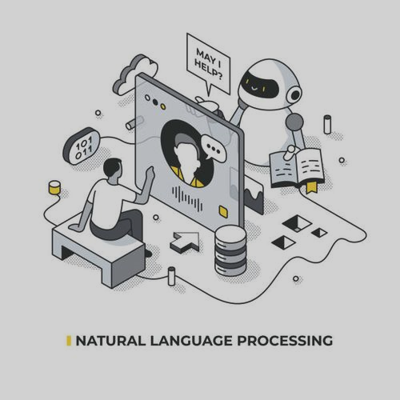
Lexical Analysis in NLP: Segmentation & Morphological Analysis
Presented By: Prasamsha Nepal

Slide 2





NATURAL LANGUAGE PROCESSING
Examples:
Chatbot and Virtual assistants:
Machine Translation:
Speech Recognition:
voice typing in google docs
It is the technology which involves converting of the spoken or written human language into a form which can be processed by computer and vice versa.
Core Tasks in NLP:
Text Analysis: The process of examining and processing written text to understand its structure and components.
Speech Processing: Speech recognition and text-to-speech (TTS) conversion.
Semantic Understanding: The process of interpreting the meaning, context, and intent behind text or speech.
Language Generation: The process of producing human-like text or speech, such as translations, summaries, or chatbot responses.

Slide 3
INTRODUCTION TO LEXICAL ANALYSIS
The process of converting raw text into meaningful units such as words, sub words, morphemes
Foundation for NLP tasks (translation, sentiment analysis, search engines)
Handles languages with complex word structures. for e.g., Arabic, Turkish
Key tasks:
Segmentation
Morphological Analysis

Slide 4
Segmentation
Segmentation is the process of Splitting text into tokens which is why it’s also called tokenization.
A good segmentation is based on the correctness of the syntax ,semantic and pragmatic structure.
Types:
Word Segmentation: Dividing a sentence into individual words or tokens.
Sub-word Segmentation: Breaking words into smaller units like syllables or characters.
Sentence Segmentation: Dividing a paragraph into individual sentences.

Slide 5
TYPES OF SEGMENTATION
Word Segmentation: Splitting a sentence into individual words or tokens. Input: NLP is powerful!
Output:
NLP
is
powerful
!

Slide 6
TYPES OF SEGMENTATION
Sub-word Segmentation : Breaking words into smaller parts which is also used in deep learning. Word: unhappiness Output:
un
happi
ness

Slide 7
TYPES OF SEGMENTATION
Sentence Segmentation: Breaking a paragraph into separate sentences. Input:
I like NLP. It’s fun. Let's learn more!
Output:
I like NLP.
It’s fun.
Let's learn more!

Slide 8

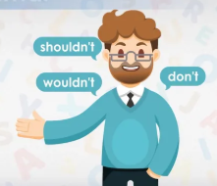
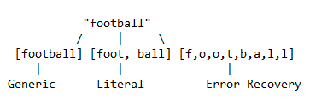
Challenges of segmentation
Languages without spaces
Contractions
Ambiguities:
Same text → multiple valid tokenization.

Slide 9
MORPHOLOGICAL ANALYSIS
Morphological Analysis is the process of recognizing the suffices and prefixes that are attached to the word
We do this by: Prefixes +root + suffixes
Prefixes: A prefix is a group of letters added at the beginning of a word to change its meaning. E.g: un+happy →unhappy, re+do → redo
Root: It is the part to which prefixes and suffixes are added. E.g: rewriting: re→prefix, write→root, ing→suffix
Suffixes: A suffix is a group of letters added at the end of a word to change its form or meaning. E.g: kind + ness → kindness, quick + ly → quickly

Slide 10
Challenges of morphological analysis
Ambiguity: Words like "leaves" can stem from different roots ("leaf" vs. "leave"), requiring context-aware disambiguation.
Irregular Forms: Irregular derivation (e.g., "go" → "went") and irregular plurals (e.g., "mouse" → "mice") defy standard rules.
Language Diversity: Combinative languages (e.g., Turkish) pack multiple morphemes into single words, complicating segmentation.

